Slide 1
Examination of the North Atlantic circulation
using Google Earth Engine
Leonie Gellweiler, Til Mohr and Sven Neubauer

Slide 2
Structure
What is the issue?
Where are specific regions?
What Datasets does GEE provide?
How did we extract and evaluate the Data?
Results
Our Examination
Papers

Slide 3
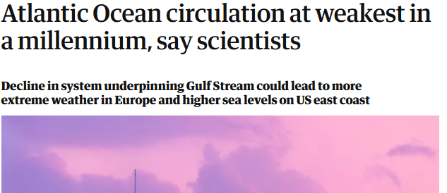
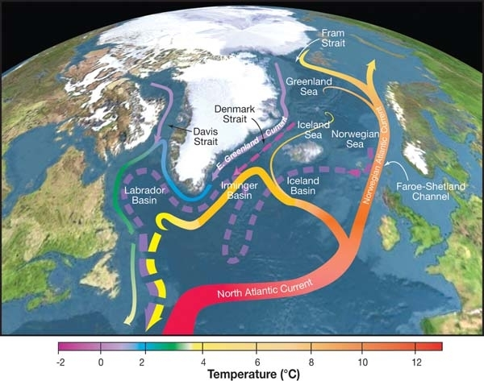
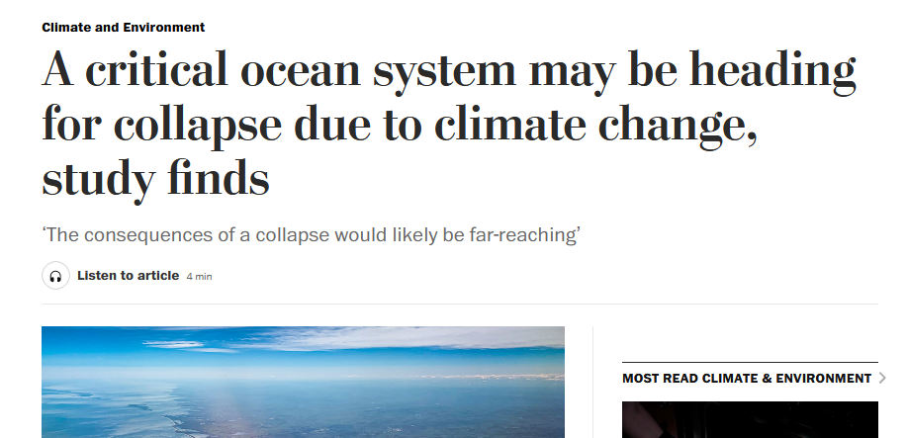
Changes in the circulation
https://www.theguardian.com/environment/2021/feb/25/atlantic-ocean-circulation-at-weakest-in-a-millennium-say-scientists
https://www.washingtonpost.com/climate-environment/2021/08/05/change-ocean-collapse-atlantic-meridional/

Slide 4
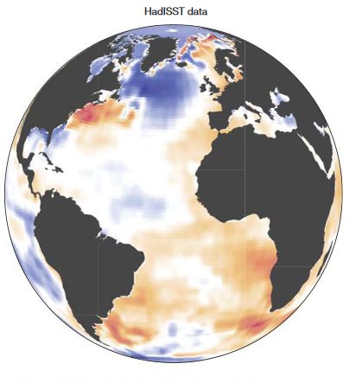
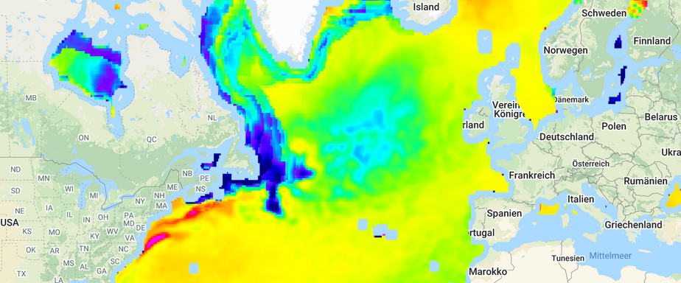
Regions
1870-2016 (Caesar et al. 2018)
Temperature Difference between 1990-2000 and 2010-2020

Slide 5
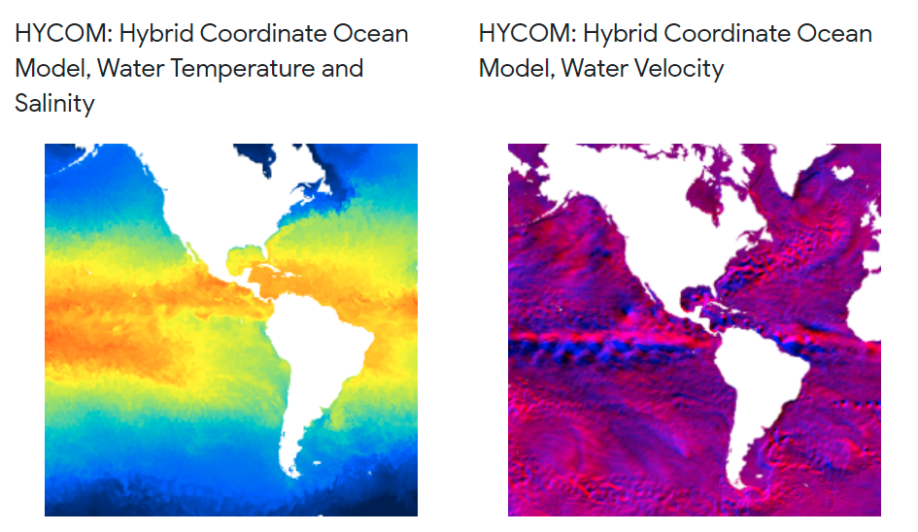
Datasets
Spatial resolution: 1/12°
Temporal resolution:
1992-10-02 - now
3h spacing
Measurements:
Temperature (C)
Salinity (psu)
Velocity (m/s)
Depths: 0m - 5000m

Slide 6


Extracting Data
A lot of Data! (10,600 days, 8 images per day, 4*40 bands per image)
→ Reduce temporal resolution: Weekly mean image (1500 images)
→ Reduce spatial resolution: min, max, mean, median, variance, skewness
~ 1000 values per week
→ 23 MB per Region

Slide 7
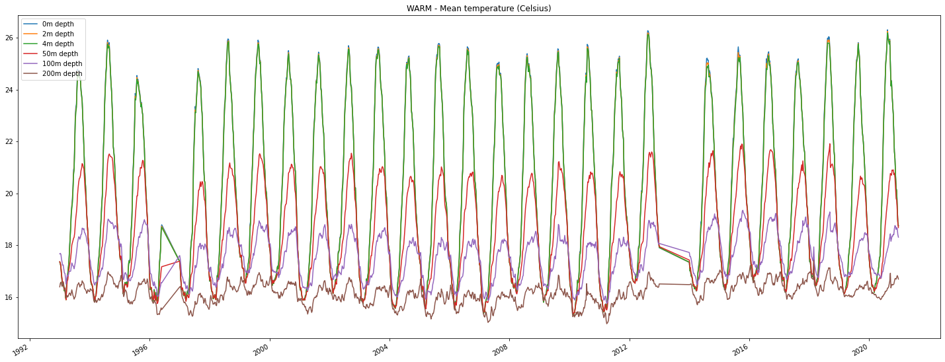
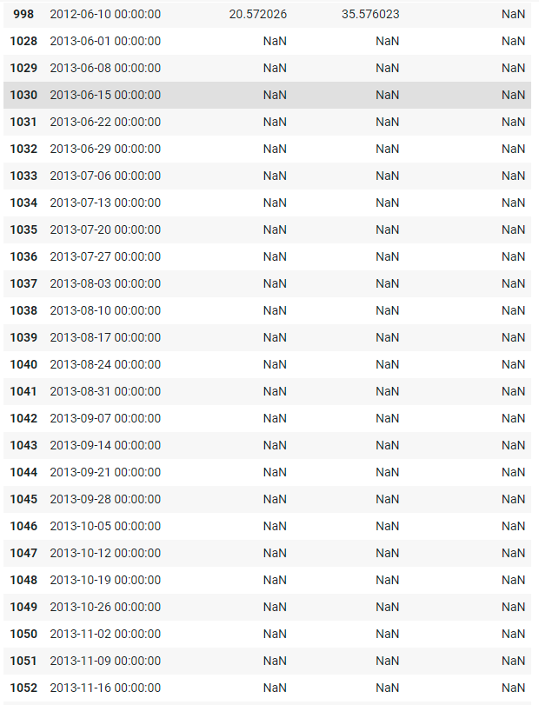
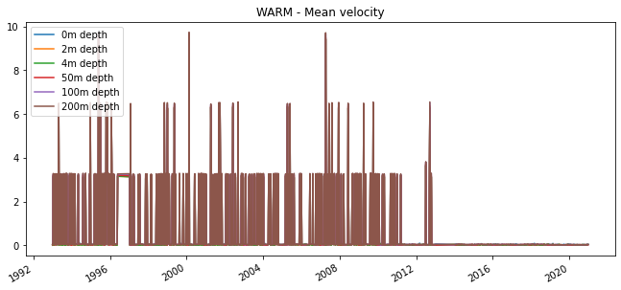
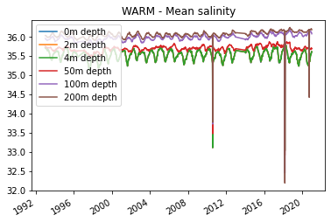
Extracting Data

Slide 8
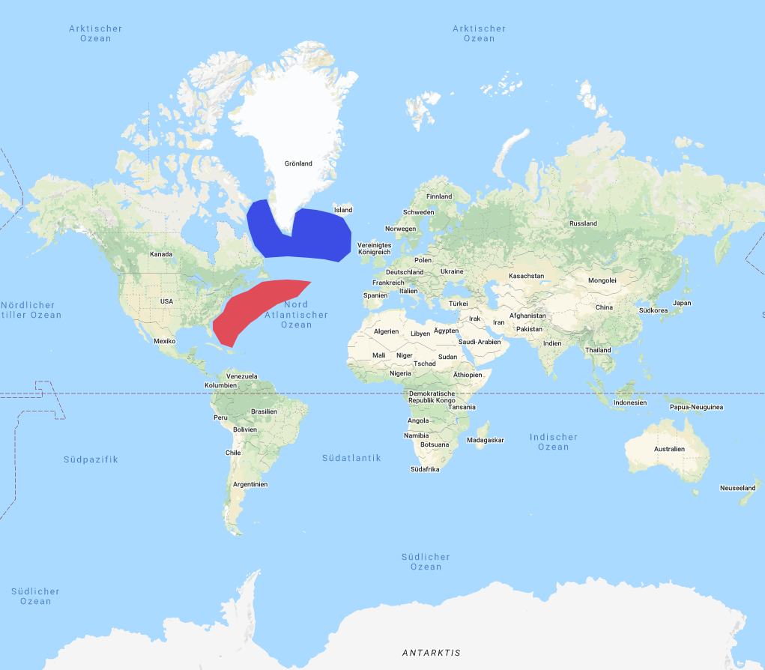
Our Results
Temperature
Salinity
Velocity
Correlations

Slide 9
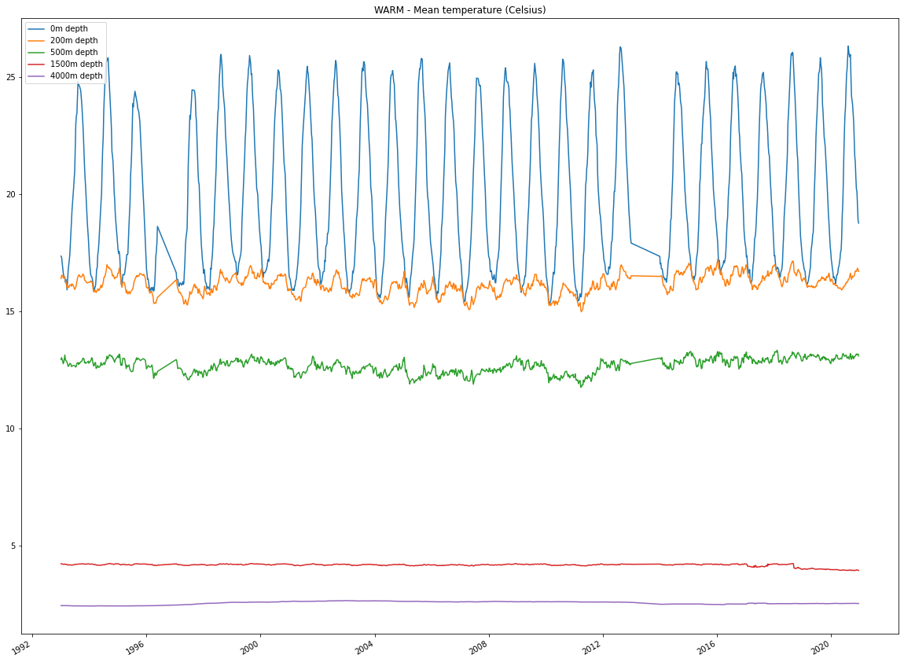
Temperature - Warm area
Temperature varies a lot in the upper sealevels
lower sealevels are not affected as strong
focus on first 500-1000m

Slide 10
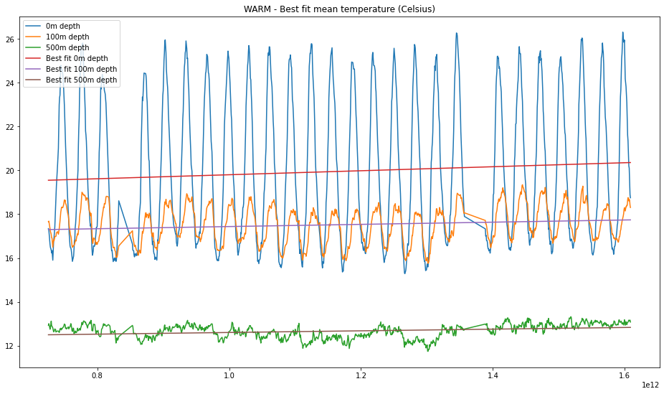
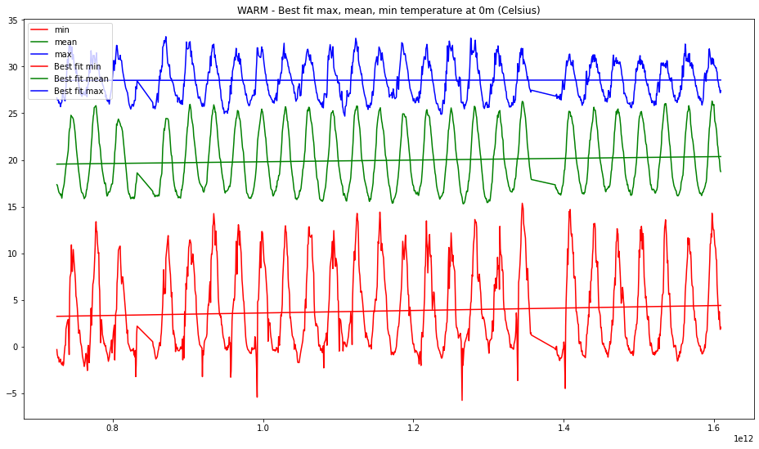
Temperature - Warm area
Warm region becomes warmer
Temperature of upper sealevels increses quickly

Slide 11
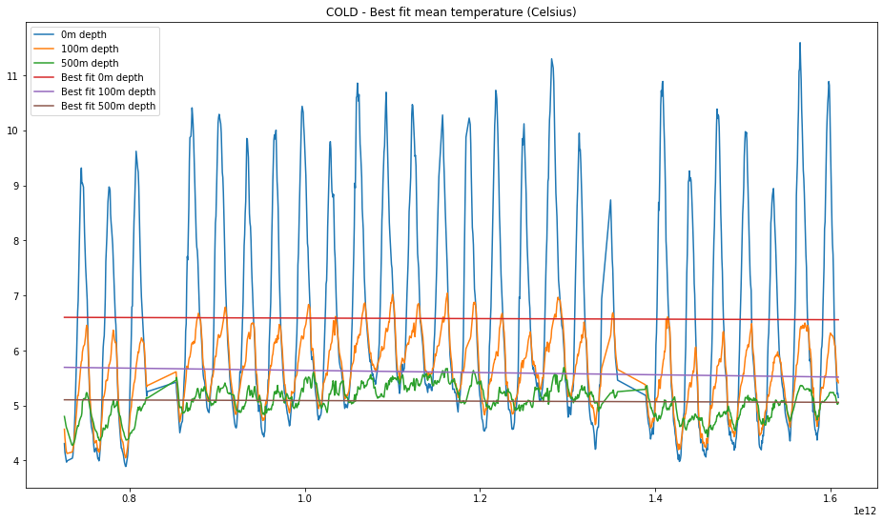
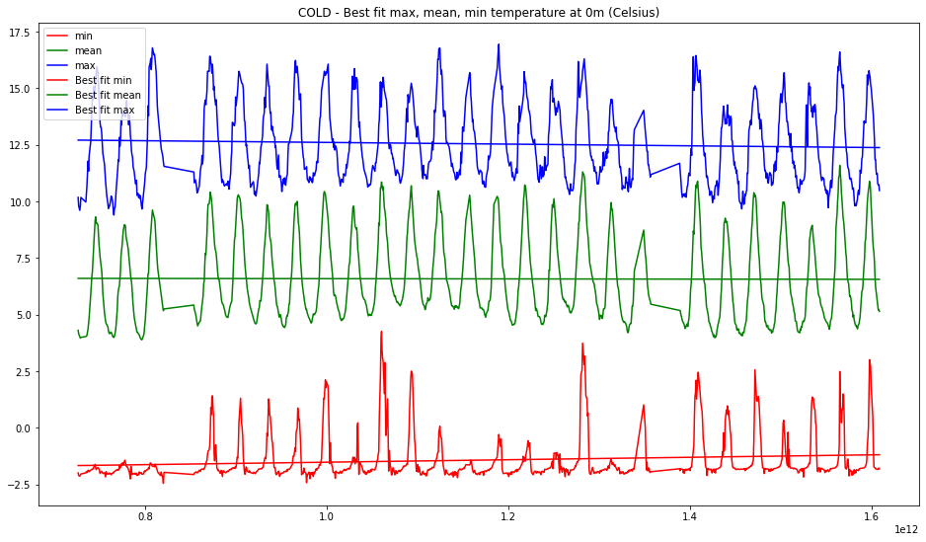
Temperature - Cold area
cold area cools down, especially around 100m depth
fresh Water that is not affected too much by weather

Slide 12
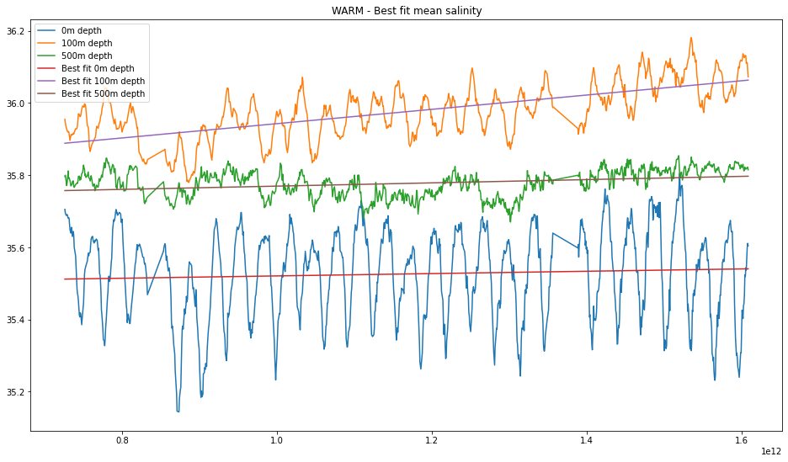
Salinity - Warm area
Salinity generally increases
steep slope around 100m depth

Slide 13
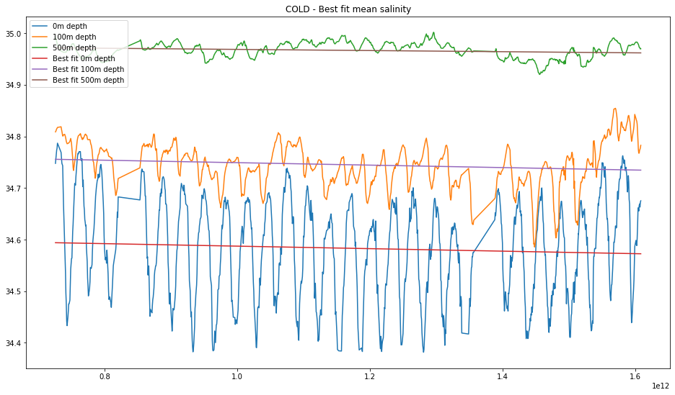
Salinity - Cold area
Salinity decreases
Glaciers melt
lower Salinity -> water is lighter and is not being pulled towards greenland

Slide 14
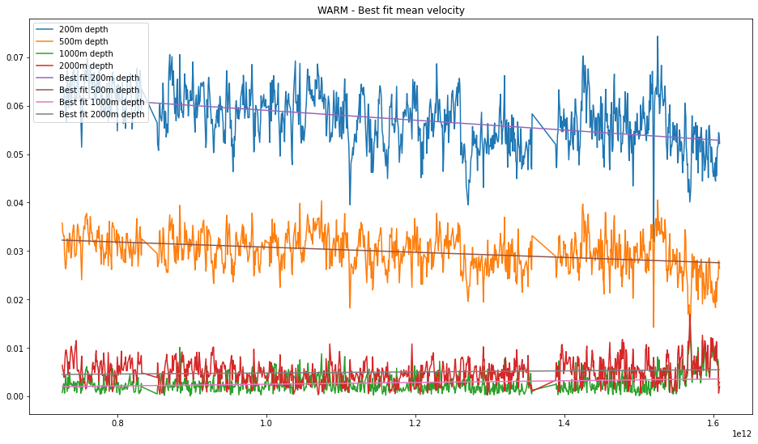
Velocity - Warm area
velocity decreases, especially in upper areas (gulf stream becomes slower)

Slide 15
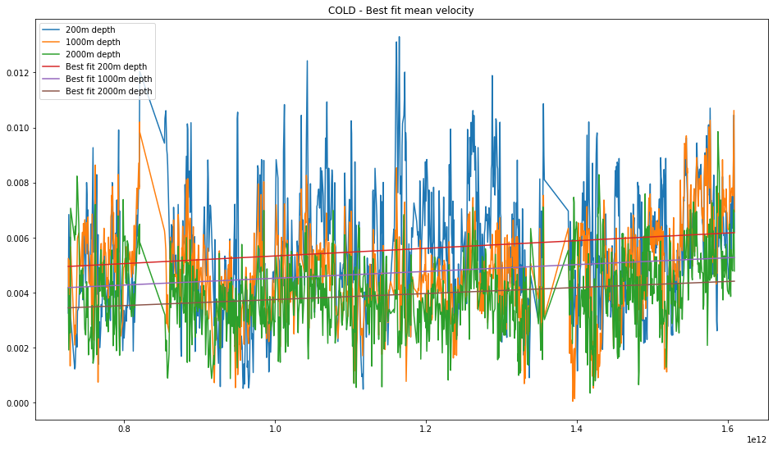
Velocity - Cold area
big deviation
graph shows upward trend
melting ice

Slide 16
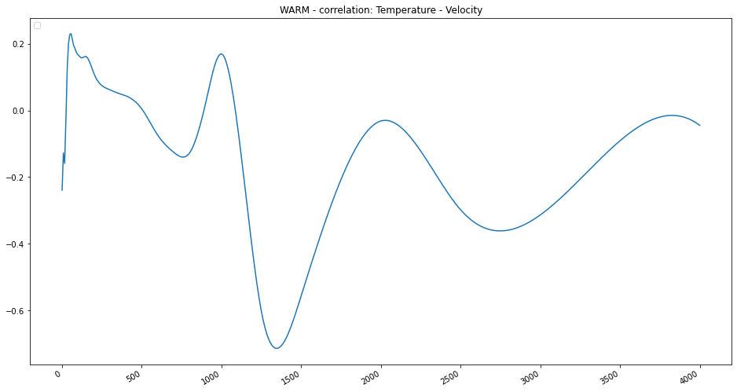
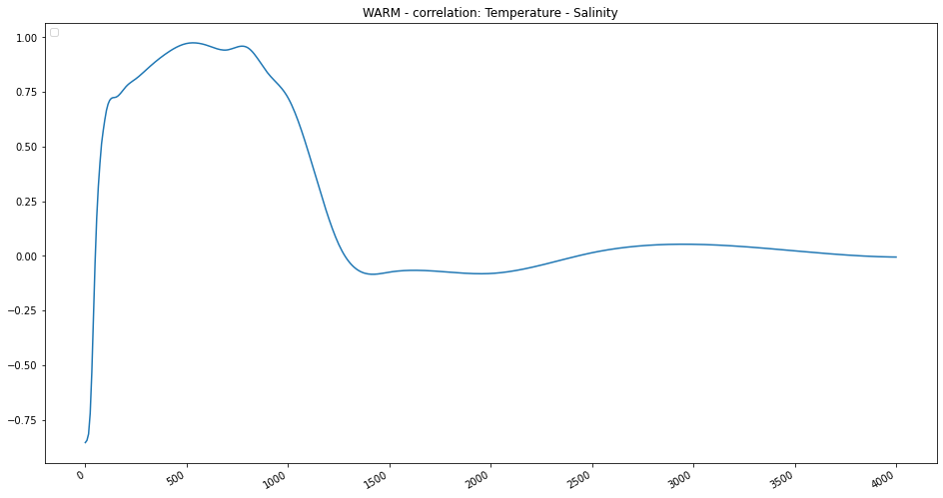
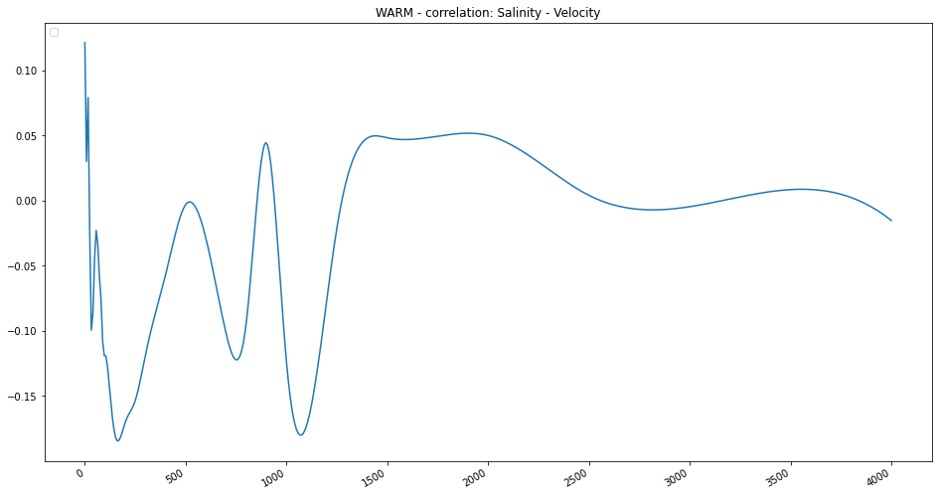
Correlations - Warm area
Most interesting: Temperature - Salinity
-> first anti-proportional, then colinear, then not correlated

Slide 17
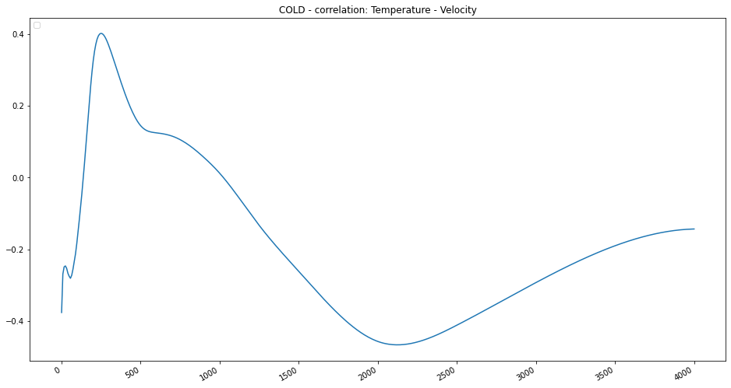
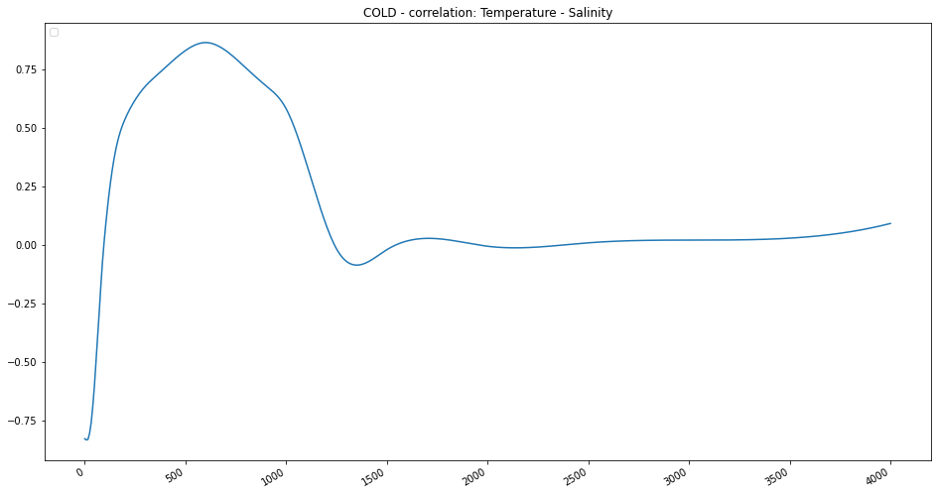
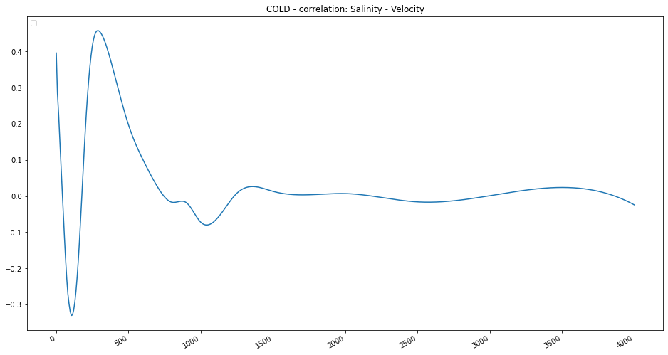
Correlations - Cold area
similar to warm area
velocity correlates better
the correlation of velocity should not be generalized from the data of one single graph

Slide 18
Summary
north: decreasing temperature and salinity
south: increasing temperature and salinity
higher amount of freshwater in the arctic region decreases salinity, further slowing down the gulf stream
would have a cooling effect on the climate around the North Atlantic region → direct warming effect is stronger
net result: still warming over land
cold patch in the ocean
when the tipping point is reached the gulf stream may collapse

Slide 19
Articles
Caesar, L.; Rahmstorf, S.; Robinson, A.; Feulner, G.; Saba, V. (2018). Observed fingerprint of a weakening Atlantic Ocean overturning circulation. Nature, 556(7700), 191–196. doi:10.1038/s41586-018-0006-5
Chen, Xianyao; Tung, Ka-Kit (2018). Global surface warming enhanced by weak Atlantic overturning circulation. Nature, 559(7714), 387–391. doi:10.1038/s41586-018-0320-y

